Slide 1


Java Academy 2020 - Project Technical Aspect
/
Location-Based Upsell

Slide 2
Agenda
FileProcessor
FileService
VoiceCallFileProcessor
DB
JMS
EventProcessor
JMS
DB
SMS
SMS-Gateway Simulator

Slide 3
File Processor – Technical Presentation

Slide 4
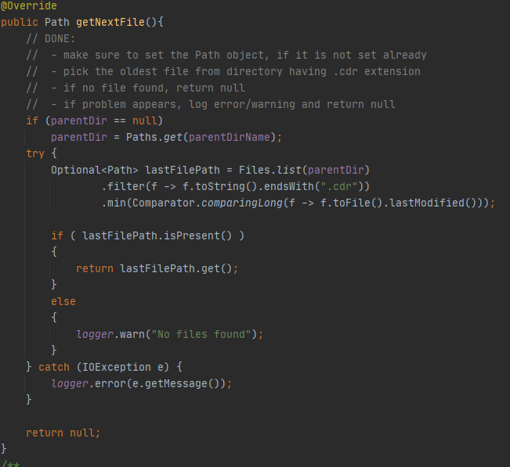
File Processor
One application per person, on our own branch​
@SpringBootApplication class: LbuFileProcessorApplication​
Loads the application context (LbuAppContext), which contains
the services used for processing files: File, Db and Jms Service​
Checks if the input directory from LbuConfig exists, with the ​
method directoryExists() from file service; if it doesn't exist, it is ​
created with createDirectories() method from Files Java class​
Gets next file to process in an infinite loop, with the method ​
getNextFile() from fileService​
If a new file is found, the method doProcess() from ​
VoiceCallFileProcessor class is called​
Otherwise, it sleeps for a second
McsFileService​
Method getNextFile() picks the oldest file from directory having .cdr extension​
To filter files, first it lists all of them with list method, then picks the ones with the right extension with filter, then uses a comparator to get the last modified file

Slide 5
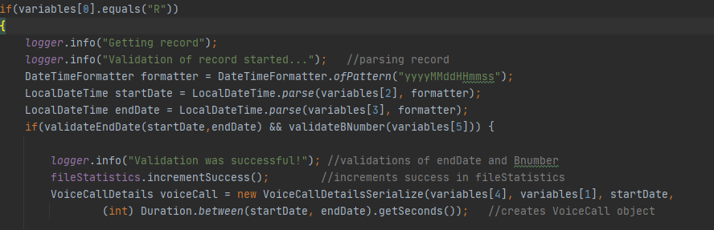
File Processor
Voice Call File Processor
After getting the file, the next step is to process its records​
In method doProcess(), it reads file record by record with a Buffered Reader​
Then, the record is processed in RecordProcessor​
RecordProcessor​
First, it parses the header, then the record. StartDate and EndDate are put into a LocalDateTime Format, from the initial pattern "yyyyMMddHHmmss", with the parse method from LocalDateTime Java class​
Each of us had to validate certain aspects of the records. For example, I had to check if EndDate was after or in the same second as StartDate; also, I had to check whether the BNumber (the number which was dialed), was less than 15 characters and not empty​
If the validation is successful, it continues with the other services, otherwise the record is written in an .error file

Slide 6
File Processor - DB service
Output 1: adding statistics about the processed files in DB
- 1 table record for each CDR file
• configure the DB connection
• set a MySQL database: either on the local machine or using docker
• Saving the statistics to DB:

Slide 7
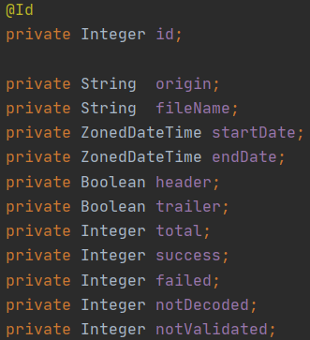




File Processor - DB service
• Creating the LbuFileStatistics entity:

Slide 8

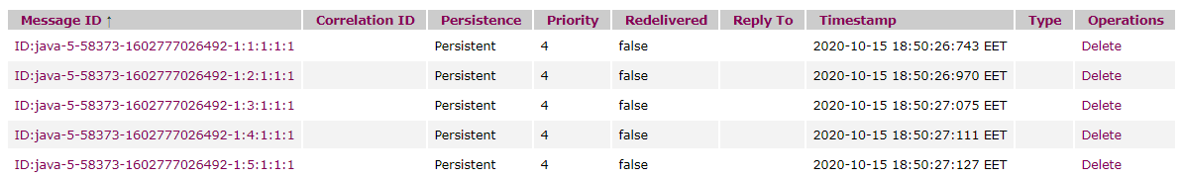
File Processor - JMS service
Output 2: for each valid record in the CDR files, it creates and enqueues a JSON object into the JMS Queue
• configure the JMS Queue using Apache ActiveMQ
• The JMS Queue:
• The JSON:

Slide 9
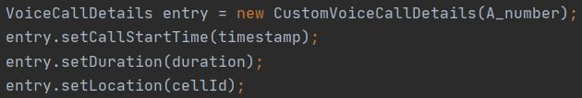
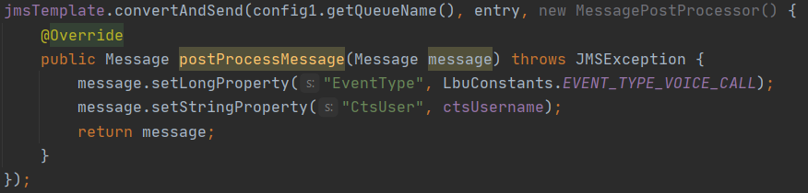
File Processor - JMS service
• The call object to be enqueued
• The enqueueCall() method using Spring:

Slide 10
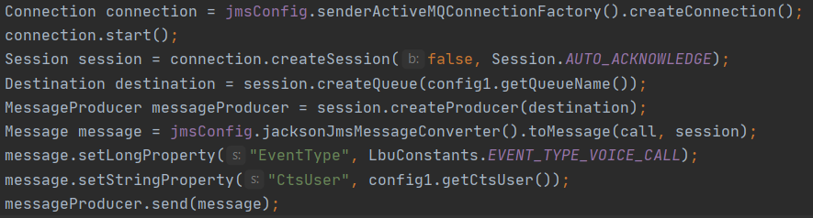
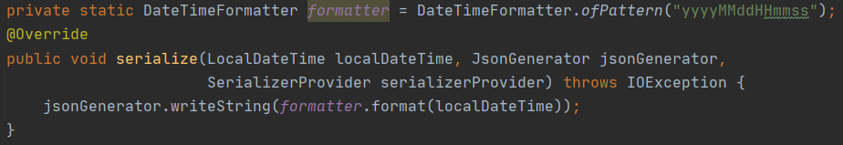
File Processor - JMS service
• The custom enqueueCall():
• Serializer for LocalDateTime that extends StdSerializer

Slide 11
Event Processor –
Technical Presentation

Slide 12
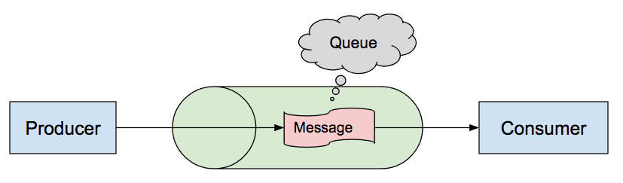
LBU Engine - JmsService
​
JMS stands for Java Message Service and it is an API used for sending
and receive messages.
A JMS Consumer was implemented to be used in receiving messages
from the JMS Provider - ActiveMQ

Slide 13
LBU Engine - JmsService
​
The way that this implementation works is defined in these steps:
In the application.properties file an ActiveMQ Broker URL has been
defined (tcp://localhost:61616) and the queue name, from which the message consumer consumes and processes messages.
A method that will dequeue the message - dequeueCall which will return
an Optional<VoiceCallDetails> like this:
a ConnectionFactory object is created which encapsulates the set of
connection configuration parameters that has been defined previously

Slide 14
LBU Engine - JmsService
​
From the ConnectionFactory object a connection is created, from which a
session is also made with the parameters false (because there is no need for transactions) and Session.AUTO_ACKNOWLEDGE (which describes the mechanism to acknowledge that the message was read from the queue).
This session will be used to create a Destination and Consumer objects.
The consumer type object is used to specify the fact that the message
will be consumed synchronously with a time out after a second

Slide 15
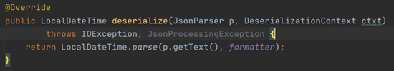
LBU Engine - JmsService
​
After checking if the message is null and if it is of type TextMessage or a
generic one, if these are true it will be converted to TextMessage.
A custom deserializer is needed for the LocalDateTime type to convert
the text message. In this purpose there was created a class that extends StdDeserializer from the Jackson package and override the deserialize method that will use the formatter to parse a String and return a LocalDateTime.

Slide 16
LBU Engine - JmsService
​
To make use of the custom deserializer, an object of type SimpleModule
is created which belongs to Json. A deserializer is added for the LocalDateTime object with an instance of the custom deserializer class and register that to the mapper.

Slide 17
LBU Engine - JmsService
​
Finally, there is initialized an object of type VoiceCallDetails using the
readValue method on the mapper, with bringing up that there is needed a constructor with no arguments on the VoiceCallDetails class which leads to creating a new class that extends VoiceCallDetails and has this type of constructor used to create an object of this type.

Slide 18
LBU Engine - DbService​
​
For database connection, we used the spring-boot-starter-data-jpa and mysql-connector-java dependencies.
DbService has responsibility to check in the database if our target(customer) is in an interest area. if it is in a Concert area or in the airport and it hasn't roaming package, it will get a promotional
SMSDbService contains methods:
Optional<InterestArea> getAreaId(String cellId)
boolean hasRoamingPackage(String msisdn)
getAreaId() is using the method findByCellId(String cellId) from JpaRepository that returns a InterestAreaCell object.
InterestAreaCell contains fields id, cellid and InterestArea object. The relationship was done using annotation @ManyToOne.
InterestAreaCell
InterestAreaCell
InterestArea
InterestAreaCell
InterestAreaCell

Slide 19
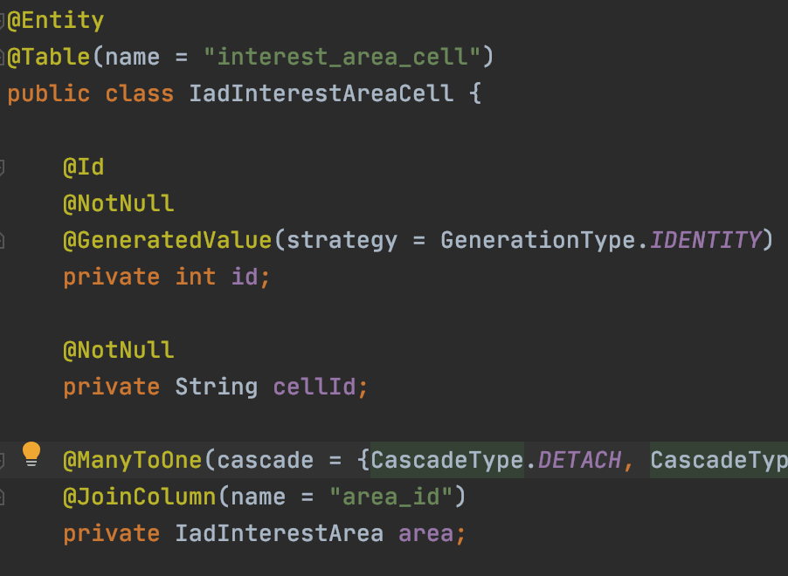

LBU Engine - DbService​
​
InterestAreaCell
id INT(11)
name VARCHAR(45)
type INT(11)
InterestArea fields:
int id, String name,
int type
List<IadInterestAreaCell>
cellIds @OneToMany(mappedBy = "area”)
Method boolean hasRoamingPackage (String msisdn) is used only for Airport cases. Based on JpaRepository with method findById() that returns an Optional<Subscriber> and than we can check if it has a roaming package or not. (Subscriber has Boolean field named – “hasRoaming”);
InterestAreaCell
id INT(11)
area_id INT(11)
cell_id VARCHAR(25)
interest_area_cell

Slide 20

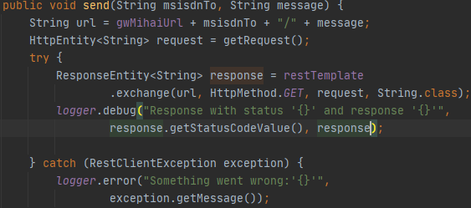

LBU Engine - SmsService
In CdrProcessor, send(msisdn, message) method will be called depending of msisdn location;
Lbu Engine uses:
To send a sms: a third-party service;
For local testing the sms service: a simulator was created;;
To switch between service and simulator: a property defined in application.properties (sms.simulate_mode=true);
The third-party service is secured and to connect to it, sms service uses basic authentication;
Send() method from SmsService takes two parameters that are used to construct the url of the third-party service;
In the send() method the getRequest() is called, where:
new header is created;
basic authentication is set with username and password defined in application.properties;
HttpEntity is returned.
RestTemplate was used in the send() method and try to make a rest call on the third-party service;
If something goes wrong, sms service catches RestClientException and logs the error;

Slide 21
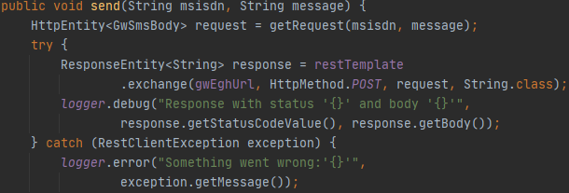
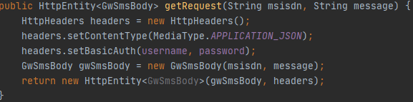
LBU Engine - SmsSimulator
The Sms Simulator has a secured POST endpoint (basic auth) that expects a request body.
In the send() method the getRequest() is called, where:
new header is created;
sets the content type to app json and the basic authentication, with username and password defined in application .properties;
new object is constructed with msisdn and message;
HttpEntity with body and headers is returned.
RestTemplate is used in the send() method and try to make a rest call on the simulator service, using the same logic as in Sms Service.

Slide 22
SMS Gateway Simulator –
Technical Presentation

Slide 23
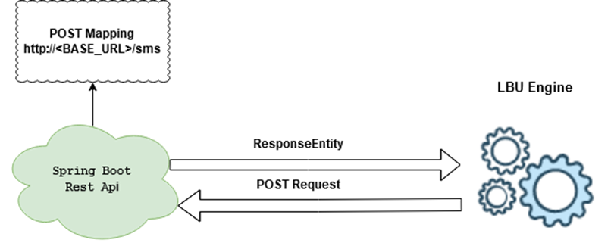
Sms Gateway Simulator

Slide 24

POST http://{BASE_URL}/sms
•Request body {"msisdn":“<>”,“message":“<>”}
•Success response:
HTTP 200 - OK
{ “status”:”MESSAGE_SENT”, “executionTime”:”0.2s”}
•Failure response:
HTTP 400 – Bad request – if msisdn is null/blank, its length is not 10 and does not start with 0 or text is null/blank
HTTP 401 – Unauthorized – wrong username/password combination
HTTP 500 – Internal server error – anything else
{“status”:”INTERNAL_ERROR”,“description":“Can not connect to SMSC“}

